Slide 1
Power Fx
What is?
Charles Lakes

Slide 2

“formula language”
“low-code”
Power Fx is built using Excel-like expressions:
Set(variableFName, “Charles”);
Notes:
Navigate();
ClearCollect();

Slide 3

Overview
General-purpose
Strong-typed
Human-friendly
Declarative
Functional
Notes:
Currently used in Power App canvas apps, but coming to the rest of the Power Platform
General-purpose:
“designed to be used for building software in a wide variety of application domains, across a multitude of hardware configurations and operating systems.” - Wikipedia
Strong-typed:
Roughly, data types have to be established early and adhered to.
E.g., strings can’t be assigned to ints, vice versa.
E.g., tables can’t be assigned to bools
Human-friendly:
I like to think any reasonable person could follow the logic.
No one’s eyes should glaze over reading Power FX code.
Declarative:
“program specifies what is to be done rather than how to do it.” – Britannica
Functional:
Roughly, languages design “to handle symbolic computation.” They are “based on mathematical functions.”
E.g., Python, Lisp
Additionally, Power Fx is open-source and developers are referred to as “makers”.

Slide 4

Advanced
Variables
Data Types
Tables
Expression grammar
YAML formula grammar
Notes:
Power FX still works w/ numbers, strings, and objects, but no like C#.
If you’re familiar w/ signed and unsigned integers, and the like, that’s not necessary here, yet.
- A number is a number.
Arrays are collections.
Objects are essentially tables.
YAML
Editable w/ any text editor like Atom or VS Code or VS
“YAML (a recursive acronym for “YAML Ain’t Markup Language”) is a data serialization language designed to be human-friendly and work well with modern programming languages for common everyday tasks”
https://yaml.org/spec/1.2.2/

Slide 5
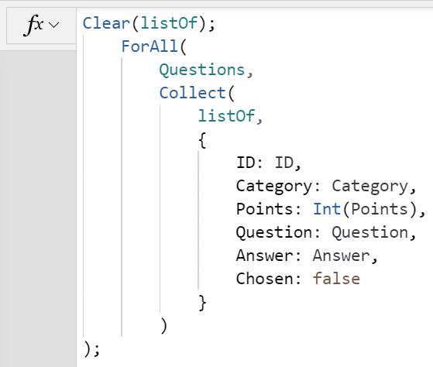
Example #1

Slide 6
Example #2

Slide 7
Example #3

Slide 8
Demo.Init();

Slide 9
https://docs.microsoft.com/en-us/power-platform/power-fx/overview
Source:
Notes:
https://docs.microsoft.com/en-us/power-platform/power-fx/overview

Slide 10
CharlesLakes.com
Contact:

